Slide 1
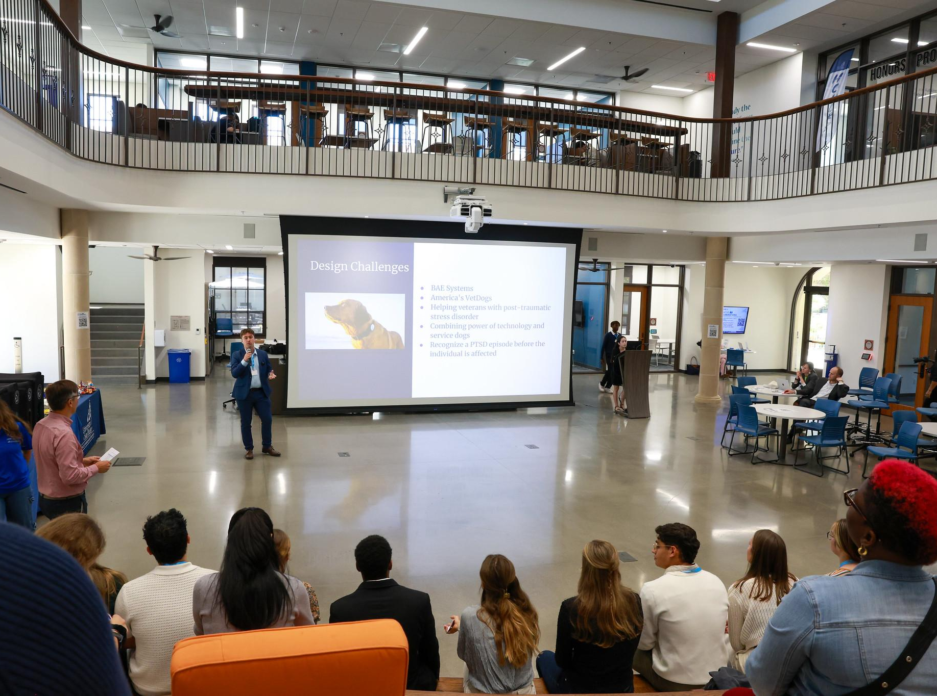
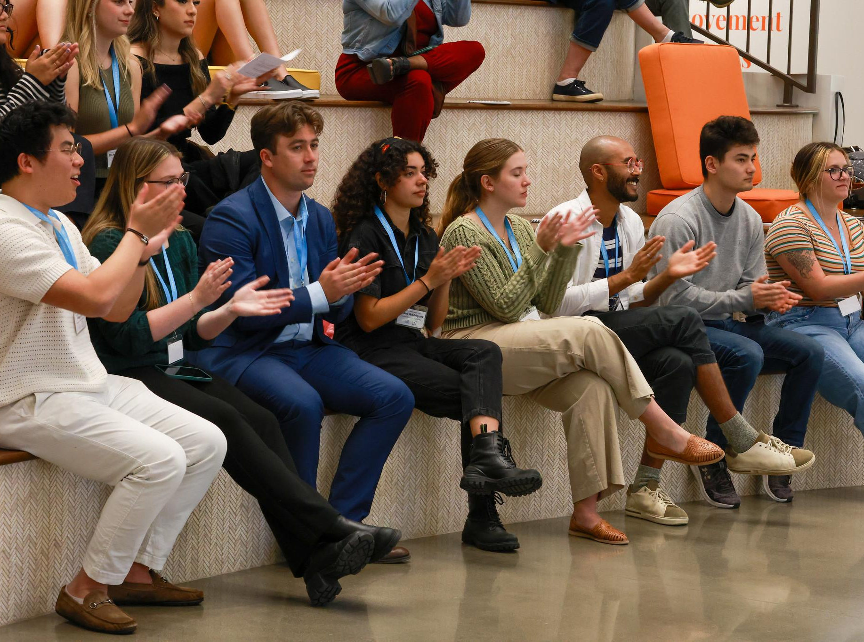
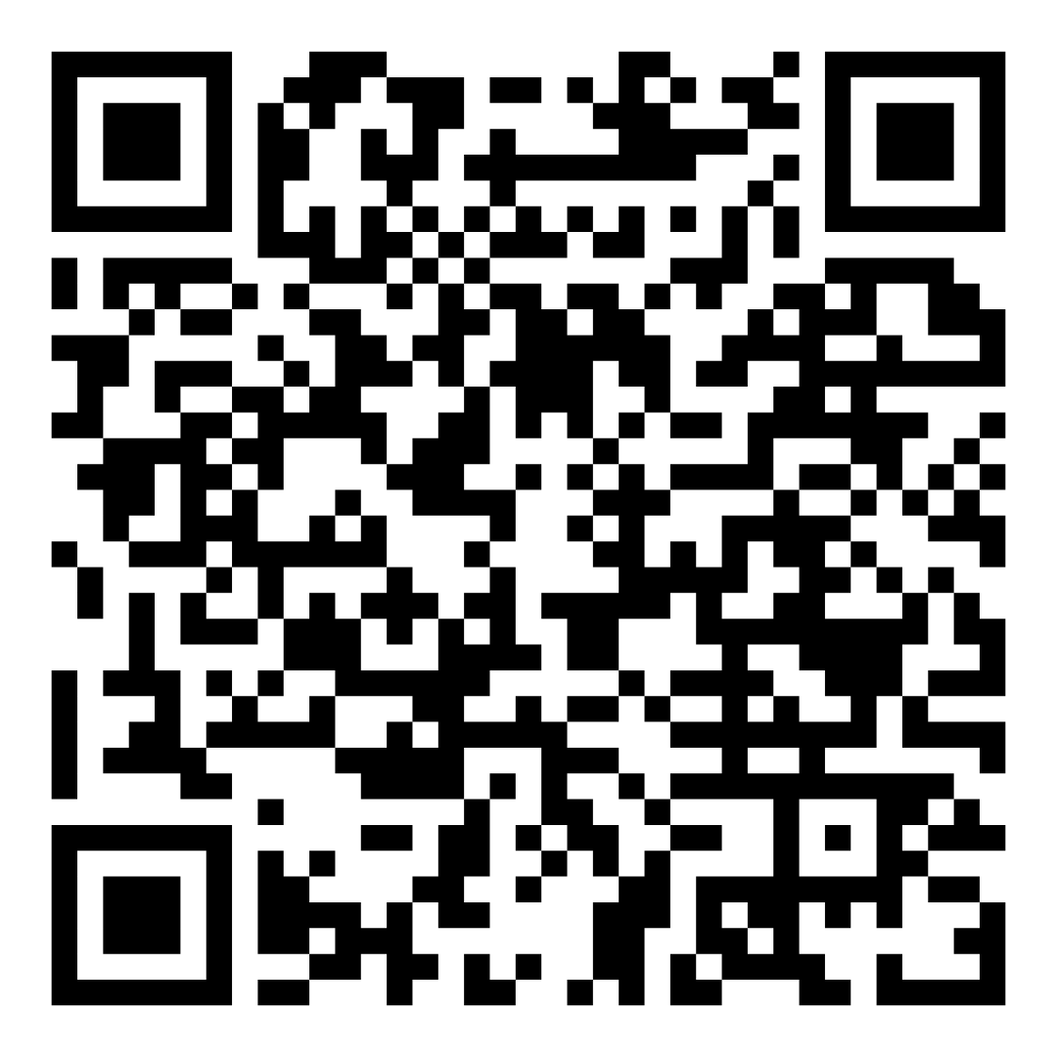
Creative Collaborations Showcase 2025
Tuesday, April 8, 2025 and Thursday, April 10, 2025
12:15 - 1:15 pm
Learning Commons Town Square
Slides/Abstract Submission Dates:
February 19 - March 19
Presentation Workshop Dates:
February 27 and March 4
https://www.sandiego.edu/ugresearch/students/creative-collaborations.php

