Slide 1
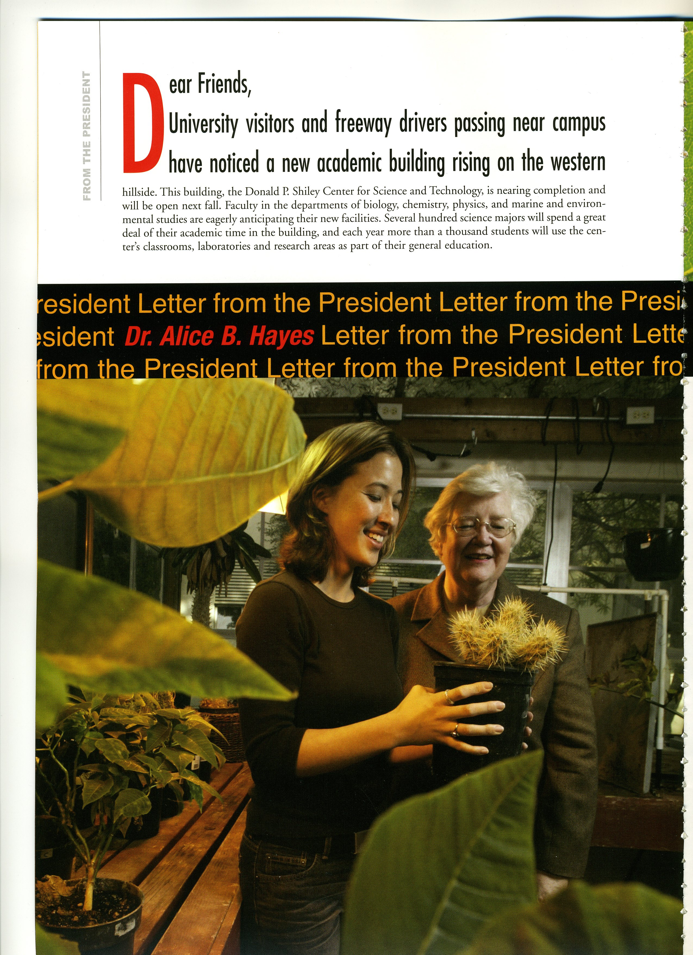
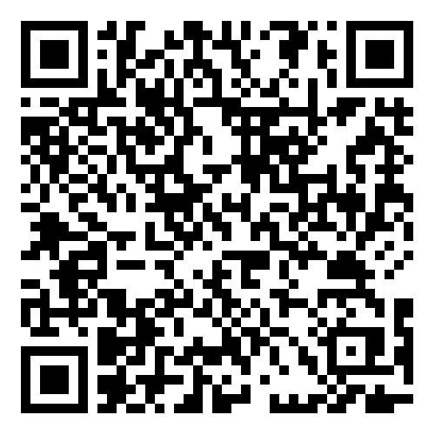

If you are a …
second or third year student at USD with a grade point average of 3.25 or higher;
declared major in the Department of Biology, Chemistry and Biochemistry, Physics and Biophysics, and Environmental and Ocean Sciences
… you are eligible to earn a scholarship or research fellowship up to $6000!
Application and more info at:
Alice B. Hayes Memorial Science Scholarships/Fellowships
https://www.sandiego.edu/cas/chemistry-and-biochemistry/scholarships.php
June 2003 marked the grand opening of the Donald P. Shiley Center for Science and Technology, and the retirement of Dr. Alice B. Hayes, President of the University of San Diego. As part of the opening of the Shiley Center, a scholarship fund in honor of Dr. Hayes was therefore established in support of students who display merit and majoring in Biology, Chemistry or Biochemistry, Environmental and Ocean Sciences, or Biophysics or Physics.
APPLICATION DEADLINE:
DECEMBER 3, 2025
Note: Previous Hayes Scholarship/Fellowship recipients are ineligible to apply. Those who have applied in the past and did not receive a Hayes Scholarship are eligible to re-apply.

